Slide 1
Deep Learning

Slide 2
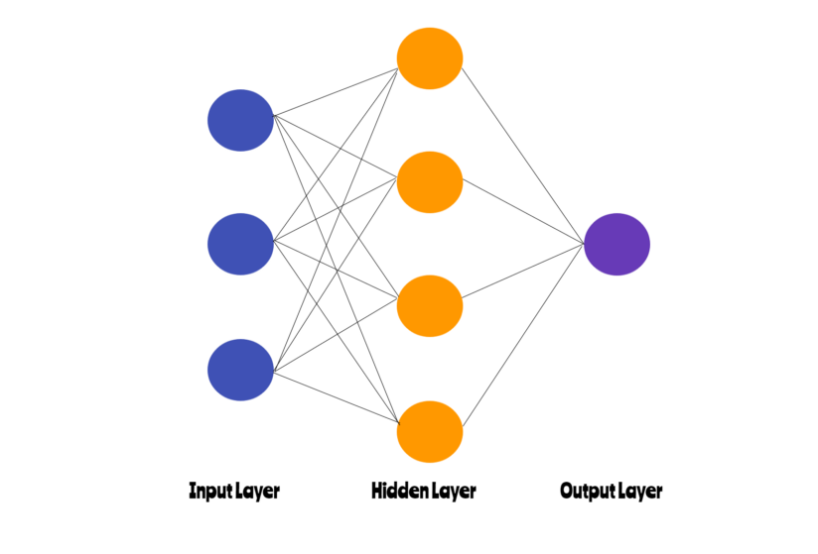
Artificial Neural Networks
ANNs are densely interconnected network of a large number of processing nodes.
These nodes are organized into layers which process data in a feed forward manner.

Slide 3
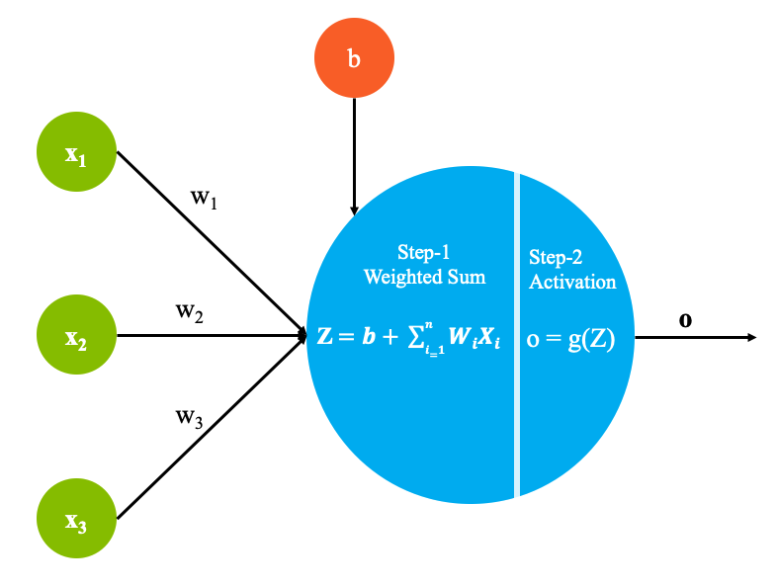
Artificial Neuron
In a neural network a neuron represents an atomic processing unit. It receives data from several nodes in the layer below it.
It multiplies the data with its weights and ads biases. The node calculates a weighted sum of all the data it receives from the layer below it.

Slide 4
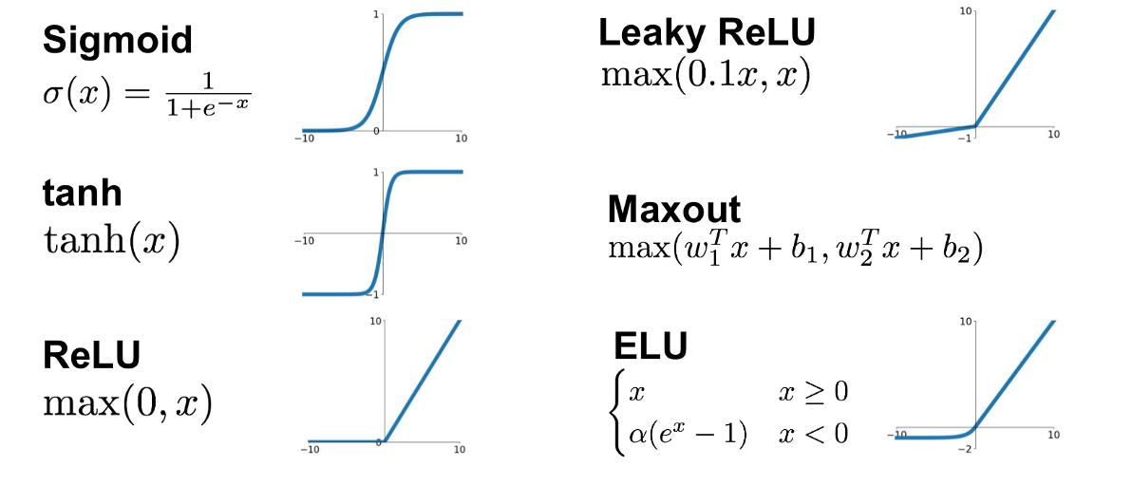
Activation Functions

Slide 5
X1
Inputs
Output
Inputs
X2
Y’ = b0+ b1X1 + b2X2 + b3X3
Sigmoid(Y’)
X3

Slide 6



Slide 7
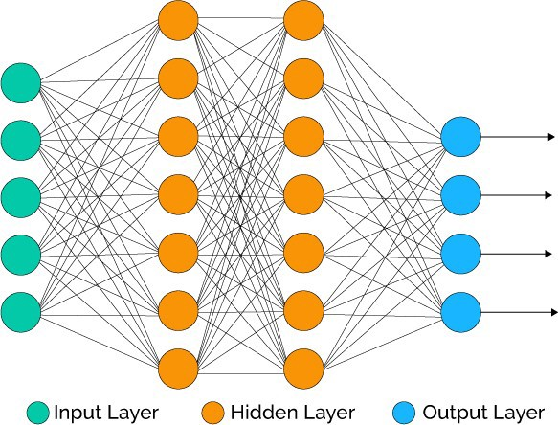

Slide 8
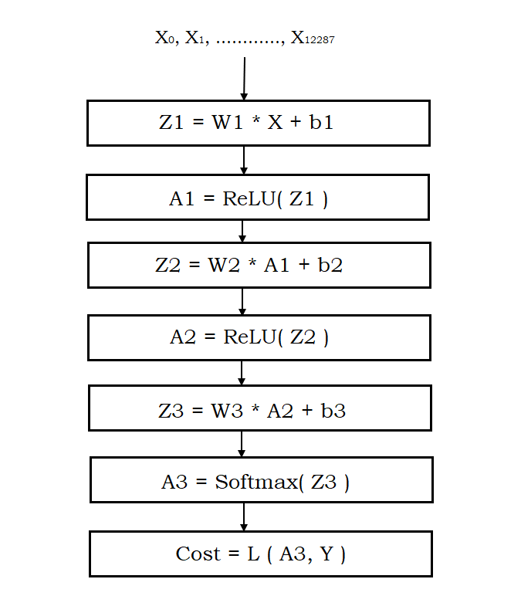
Computation Graph

Slide 9
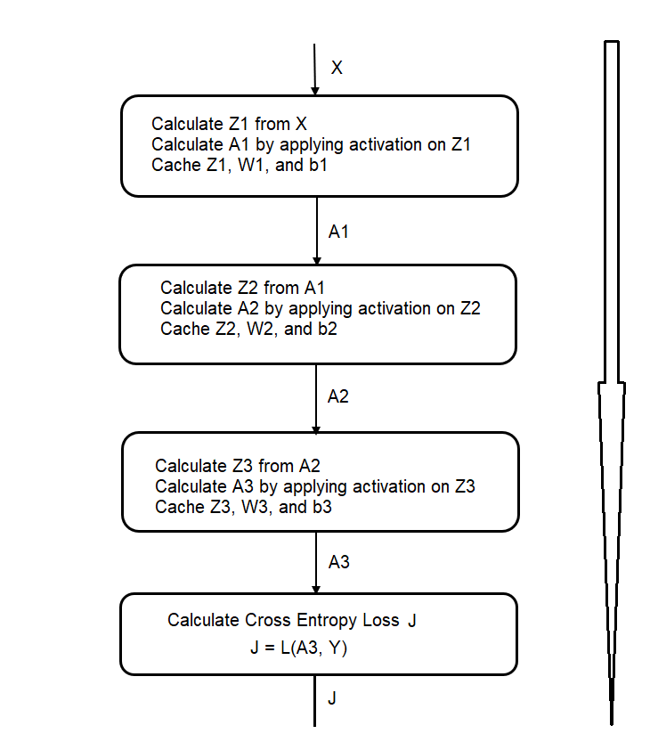
Forward Propagation

Slide 10
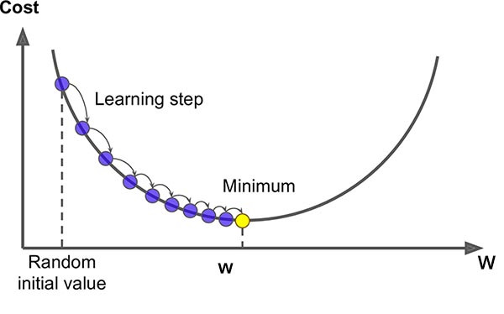
Gradient Descent
Gradient descent is an optimization algorithm used to minimize some function by iteratively moving in the direction of steepest descent as defined by the negative of the gradient.

Slide 11
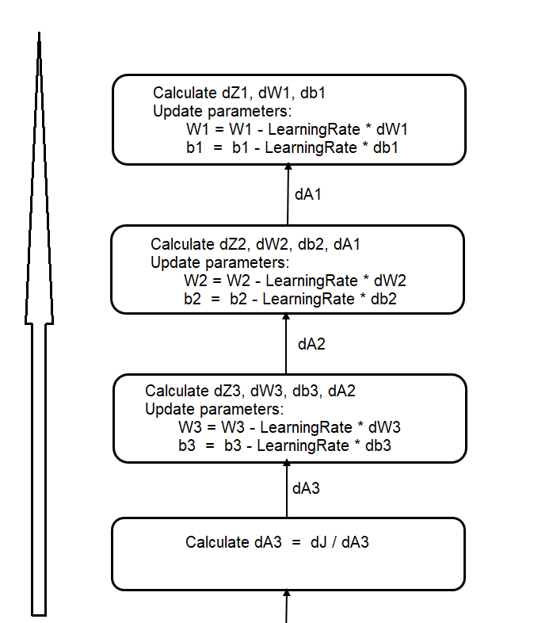
Backward Propagation

Slide 12
Forward and Backward Propagation
Inputs
Calculate Weighted sum
Apply Activation Function
Calculate Weighted sum
Apply Activation Function
Calculate Weighted sum
Apply Activation Function
Calculate Cost Function
Calculate Gradients
Update Parameters
Calculate Gradients
Update Parameters
Calculate Gradients
Update Parameters

Slide 13
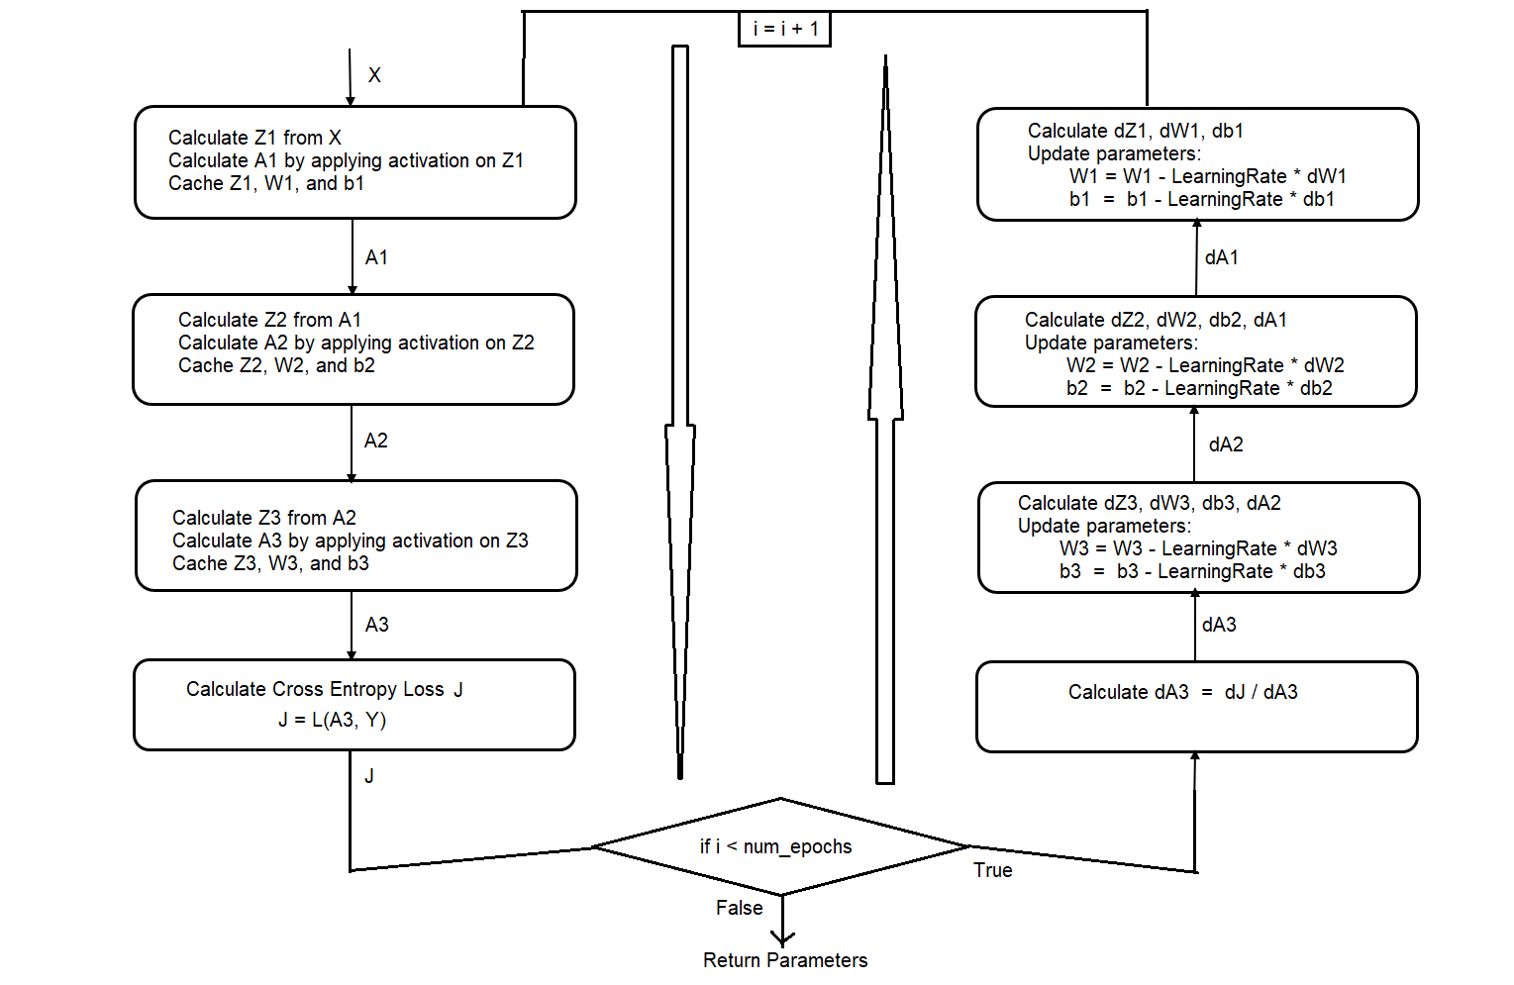

Slide 14
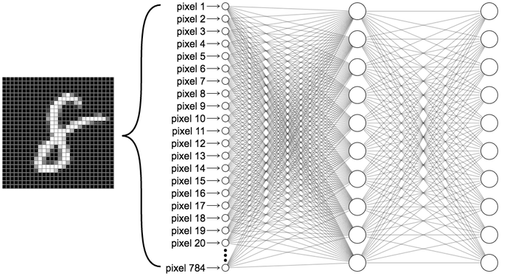

Slide 15
Gradient Descent & Optimizers
Effect of Initialization Strategy
The Problem of vanishing and exploding gradients
Gradient Descent :
Batch Gradient Descent
Stochastic Gradient Descent
Mini – Batch gradient Descent
Optimizers :
Momentum Optimization
Nesterov Accelerated gradient
RMSProp
ADAM Optimozation

Slide 16
Convolutional Neural Networks
Convolutional Neural Networks are very similar to ordinary Neural Networks which consist of neurons that have learnable weights and biases.
CNN architecture introduces two new building blocks: convolutional layers and pooling layers along with the fully connected layers.
Using deep neural networks is not feasible for tasks or applications where high resolution images are involved.
The architecture of convolutional neural networks is barely affected by the resolution of images.
Convolutional neural networks are able to pick up spatial dependencies / localities between pixels better than Artificial neural networks.

Slide 17
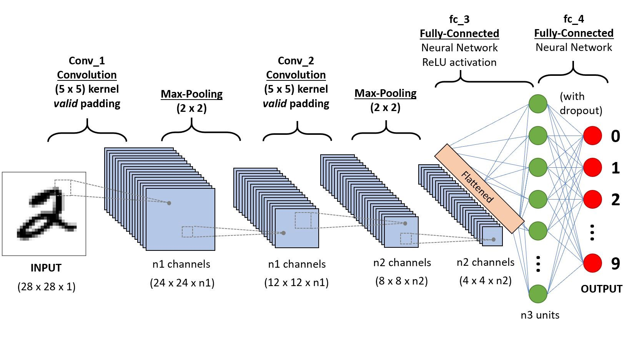

Slide 18
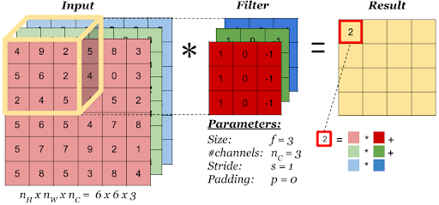

Slide 19
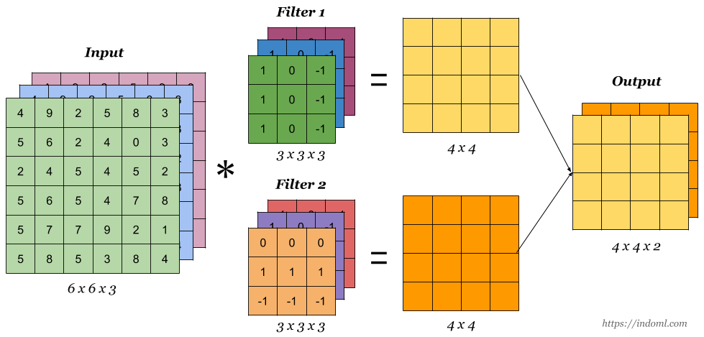

Slide 20
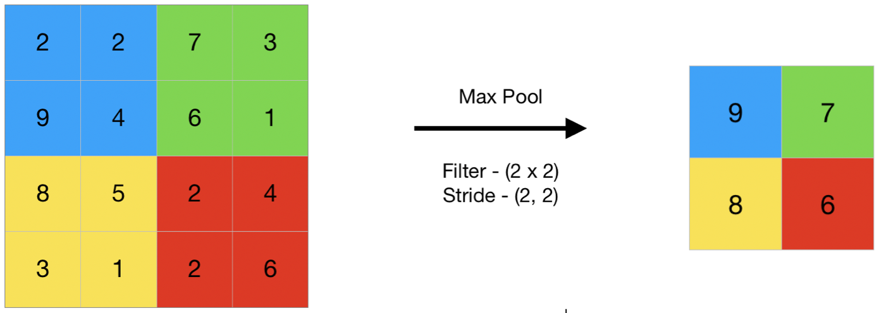
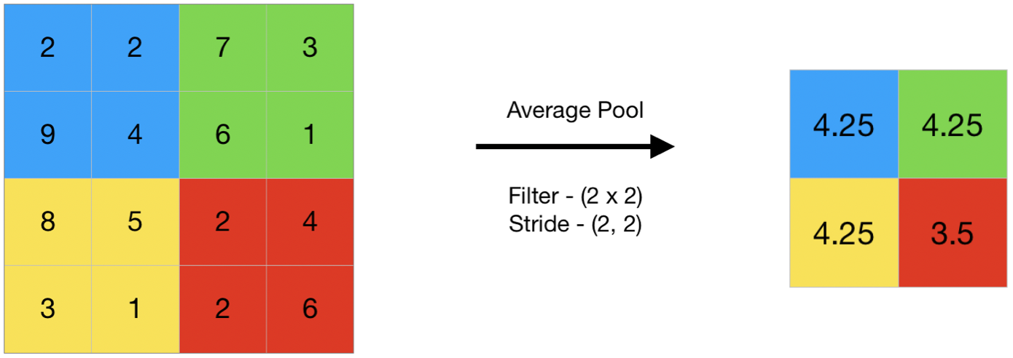

Slide 21
Pretrained Models & Transfer Learning
AlexNet
VGG16
VGG19
Inception V3
ResNet50

Slide 22
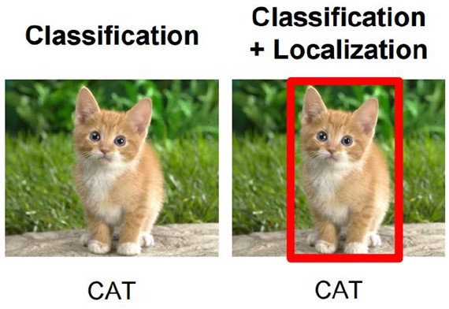
Image Classification And Localization

Slide 23
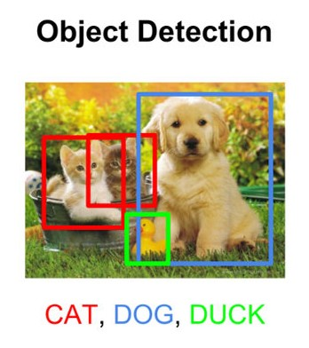
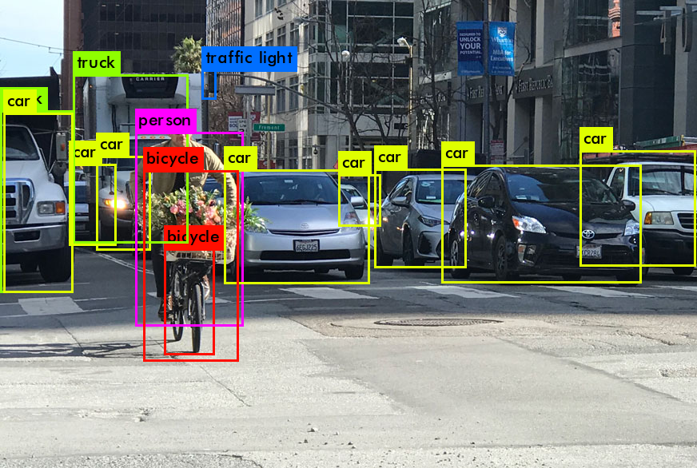
Object Detection
Object detection is a task in computer vision that involves identifying the presence, location, and type of one or more objects in a given photograph.

Slide 24
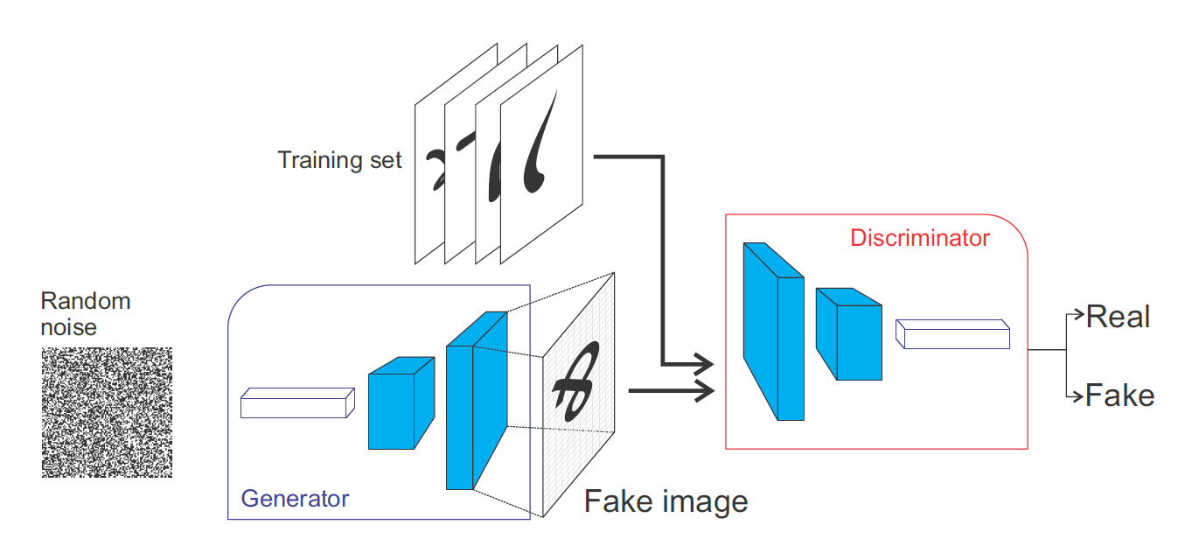
Generative Adversarial Networks

